Slide 2
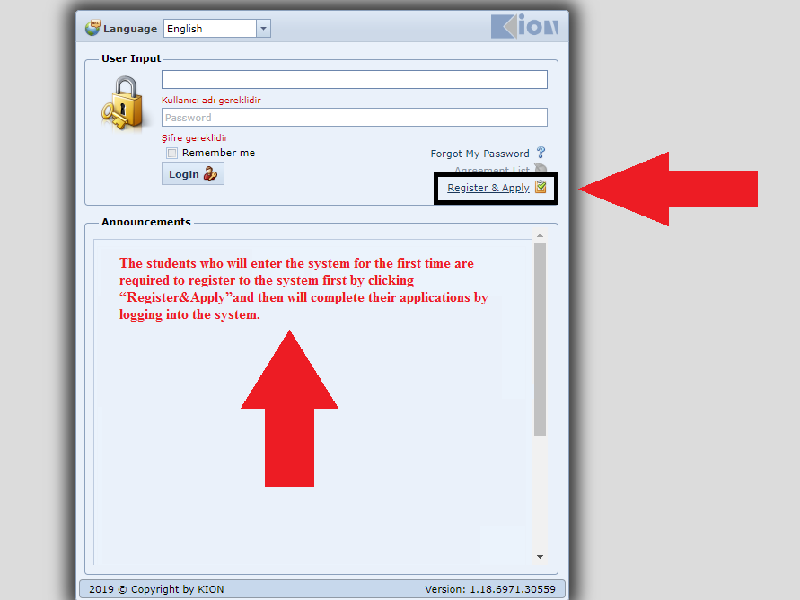
If you already have a username and password, please go to 8th slide.

Slide 3
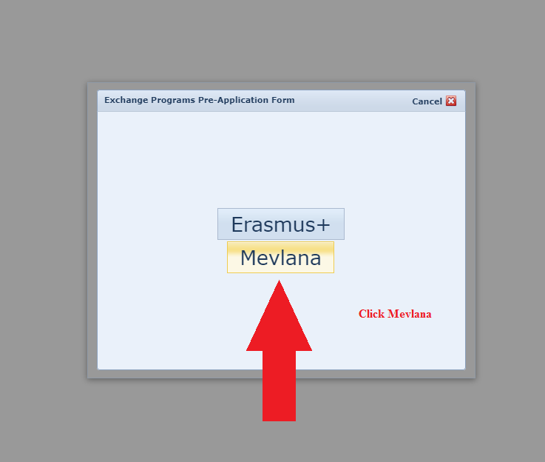

Slide 4
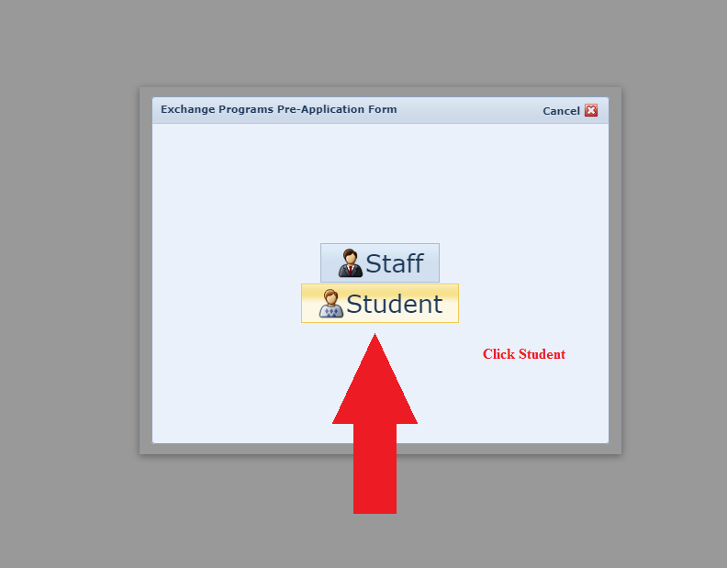

Slide 5
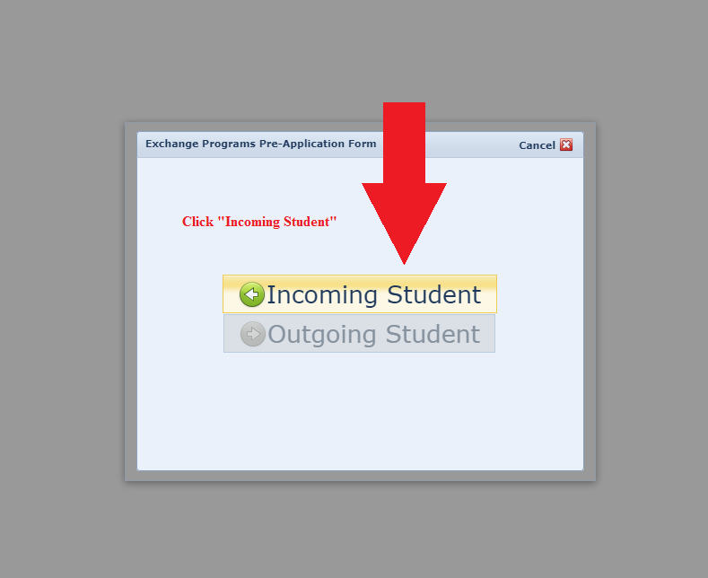

Slide 6
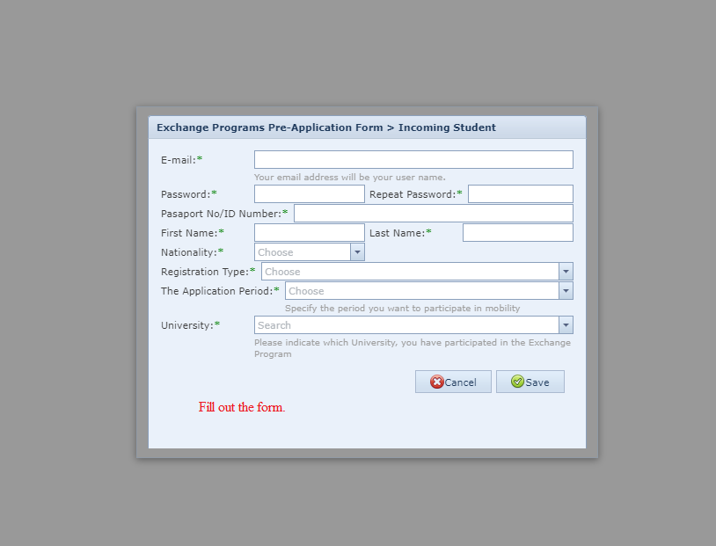

Slide 7
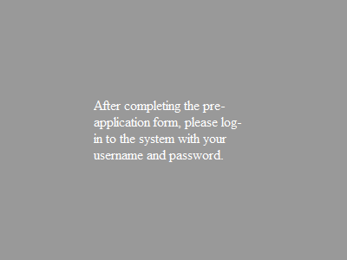

Slide 8
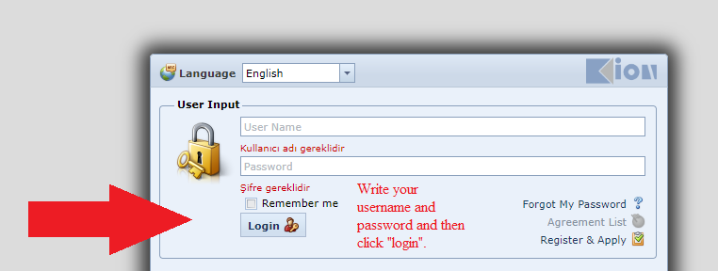

Slide 10
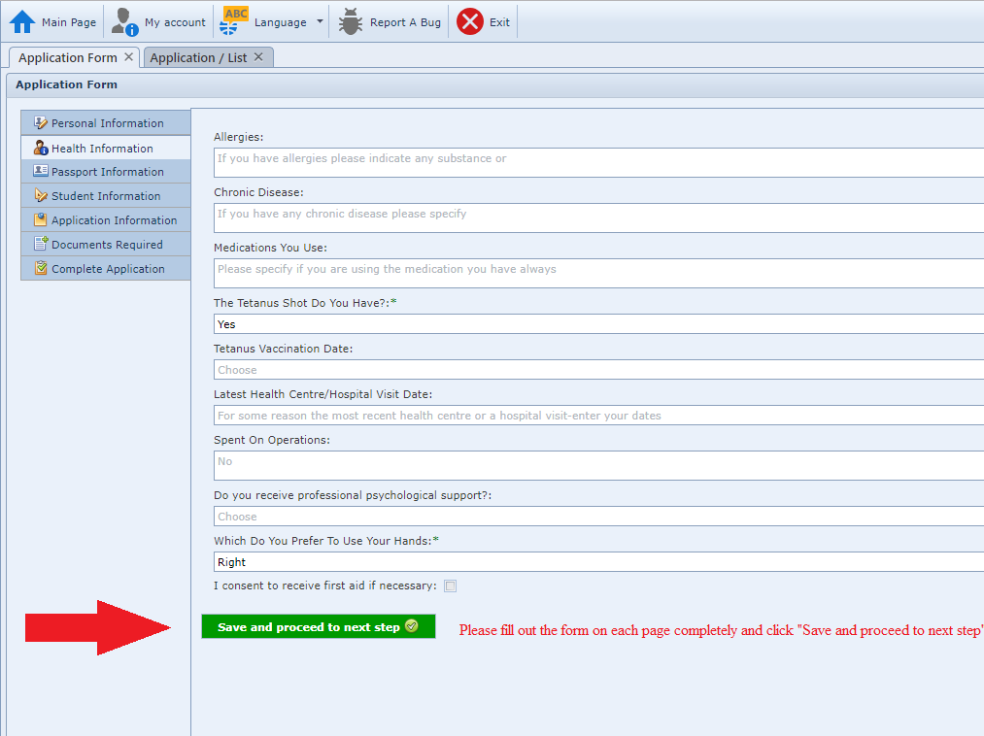

Slide 11
Your transcript of records must be in English.

Slide 12
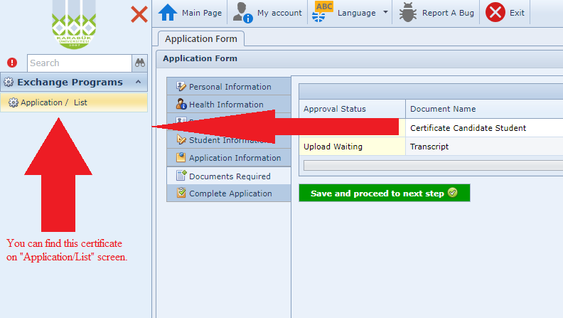

Slide 13
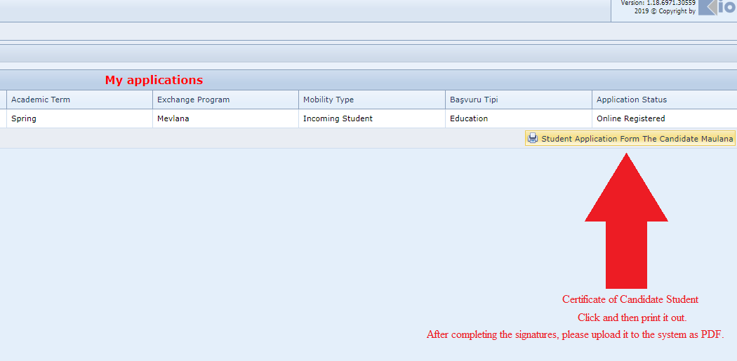
IMPORTANT:
This document must be signed by the applicant and the head of International Relations Office or his/her counterpart. Also, it must be sealed by the related department.

Slide 14
