Slide 2
Content of Presentation
Great Achievements @ UNIKA
Great History @ UNIKA
Great Team @ UNIKA
Great Learning @ UNIKA
Great Global @ UNIKA

Slide 3
GREAT History @ UNIKA
THE HISTORY OF UNIVERSITY OF KARABUK
2007
2015
2019
Number of Students: 4.685
Number of Students: 35.000
Number of
International Students: 234
Number of Students: 51.874
Number of
International Students: 8.050
IN 2007 WHEN UNIKA
WAS FOUNDED IT HAD:
4 FACULTIES
1 VOCATIONAL SCHOOL
2 COLLEGES

Slide 4
GREAT Team @ UNIKA
FACULTIES
SENATE
RECTOR
VICE RECTORS
INNER CONTROL
GENERAL SECRETARY
ACADEMIC UNITS
BOARD OF MANAGEMENT
ADMINISTRATIVE UNITS
COLLEGES
VOCATIONAL SCHOOLS
INSTITUTES
RECTORATE
RESARCH CENTERS
ADMINISTRATIVE
1- Dentistry
2-Letters
3-Sciences
4-Economics and Administrative Sciences
5-Theology
6-Communication
7-Business Administration
8-Architecture
9-Engineering
10-Forestry
11-Fine Arts and Design
12-Tourism
13-Health Sciences
14-Technology
15-Medicine
1-Physical Education and Sports
2-Health Sciences
3-Civil Aviation
4-Foreing Languages
1-Justice
2-Eflani Vocational School
3-Eskipazar Vocational School
4-Technical Sciences
5-Safranbolu Vocational School
6-Health Services
7-Social Sciences
8-Yenice Vocational School
1-Iron and Steel Institute
2-Graduate Institute of Education
1-Press and Public Relations Office
2-Department of Foreign Language
3-Department of Turkish Language
4-International Relations Office
5-Department of History of Turkish Revolutian
6-SRP Office
7-Conference Coordination Unit
8-Vocational Schools Coordination
9-Central Directore of Circulating Capital
10-Legal Consultancy Department
1-Cengiz AYTMATOV Turkish World Research and Application Center
2-Child Development
3-Experimental Medicine
4-Energy and Environmental Technology
5-Education for People
6-Traditional and Complementary Medical Practices and Research Center
7-Occupational Health
8-Continuing Education Research
9-Women’s Studies Research
10-Robot Technology Research
11-History, Culture and Art Research Center
12-Turkish Language Teaching
13-Distance Education Research and Application Center
14-Children’s University
15-Renewable Energy Engineering Institute
1-Student Affairs Department
2-Healt, Culture and Sports Department
3-Library Department
4-Administrative and Financial Affairs
5-Strategy Development
6-Directorate of Construction
7-Information Technology
8-Directorate of Personnel Department

Slide 5
GREAT Team @ UNIKA
1028
ACADEMIC
Professor
14.2%
111
Associate Professor
12.6%
99
465
ADMINISTRATIVE STAFF
Doctor
42.7%
334
Research Assistant
267
30.3%
237
SUPPORT STAFF

Slide 6
GREAT Learning @ UNIKA
51.874

Slide 7
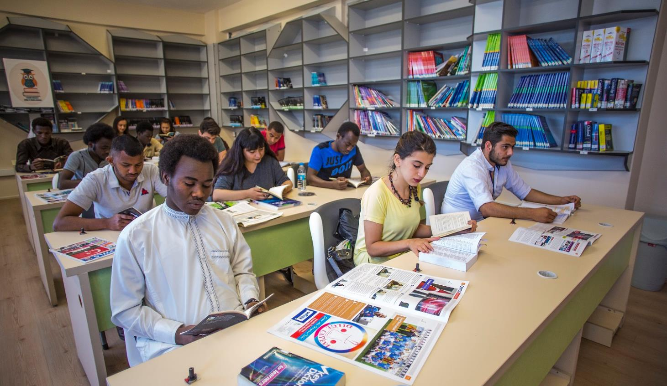
GREAT Learning @ UNIKA
UNIKA is the first public university also accredited by EAQUALS (The European Association for Quality Language Services) with its School of Foreign Languages in Turkey. EAQUALS is the most prestigious accrediting agency started in 1991.

Slide 8
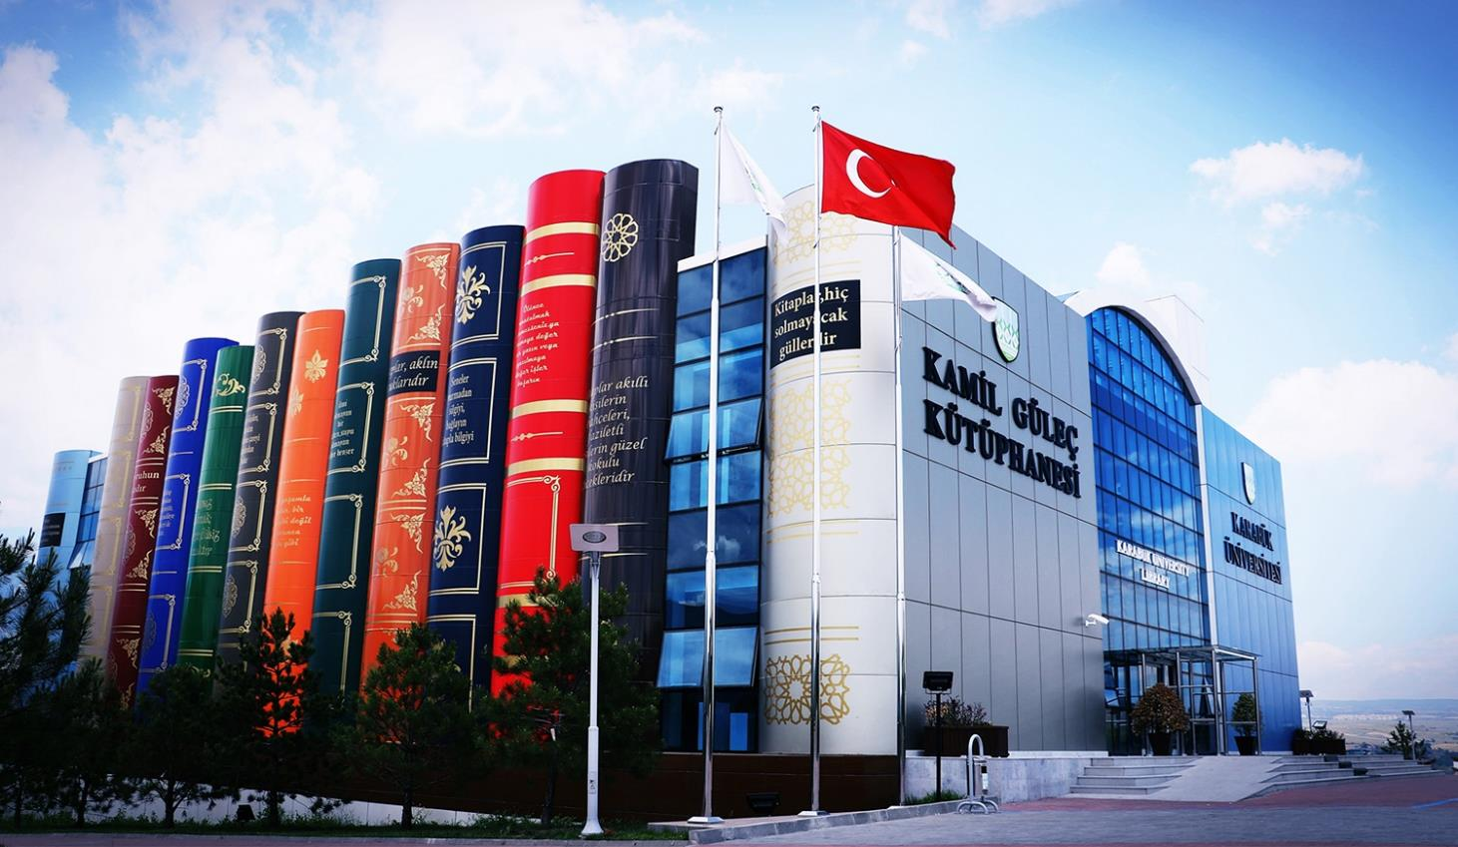
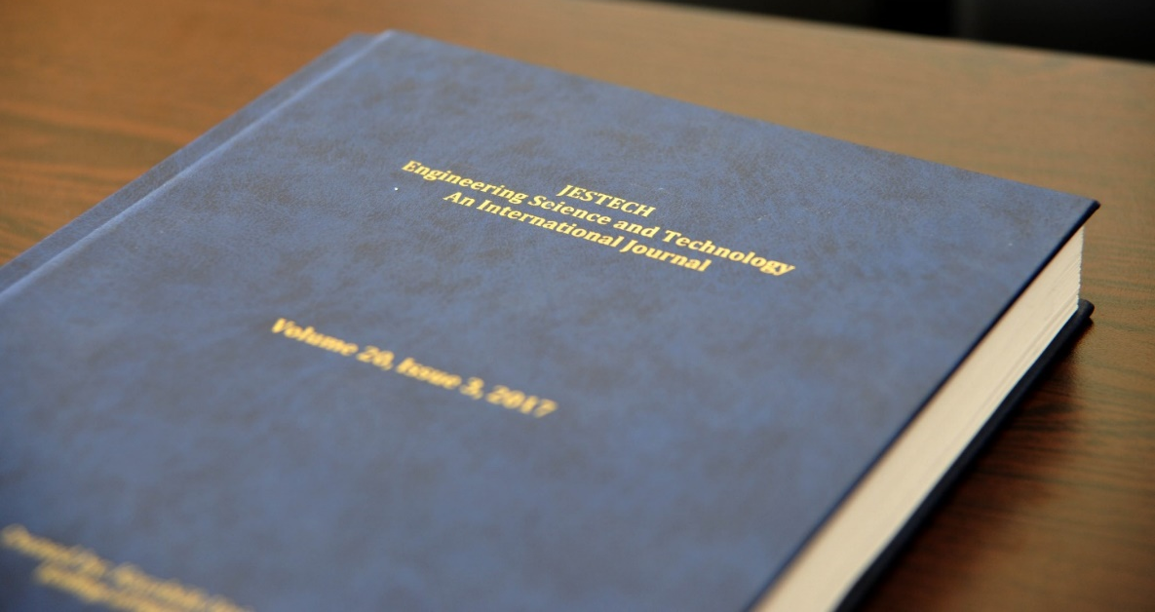
GREAT Learning @ UNIKA
Published Books: 90.254
Journals: 131
Newspapers:16
e-books: 27.200
e-journals: 31.073
Visitings per year: 500.000
JESTECH, the international refereed journal of UNIKA, is being scanned within the scope of “Science Citation Index - Expanded (SCI-Expanded).

Slide 9
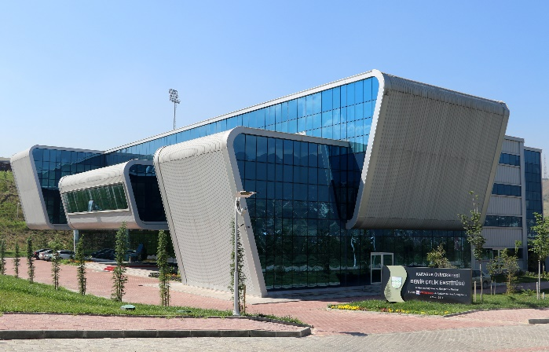
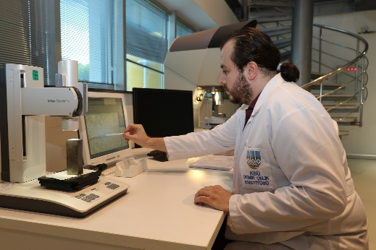
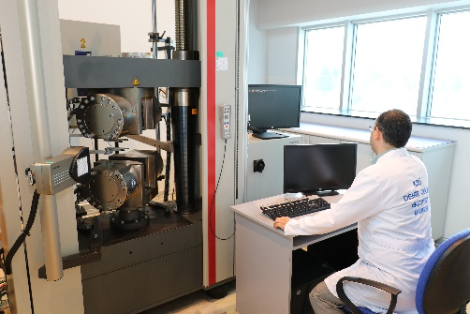
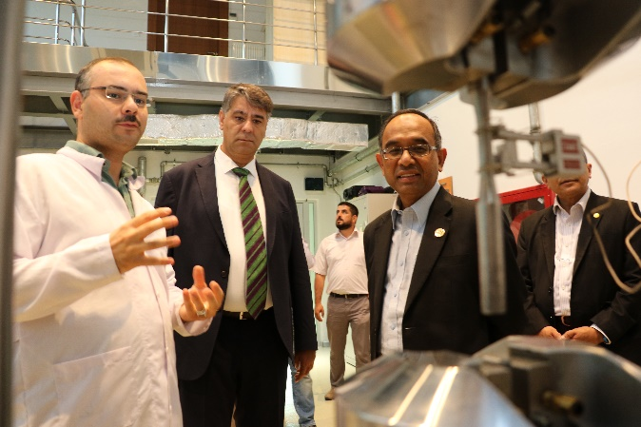
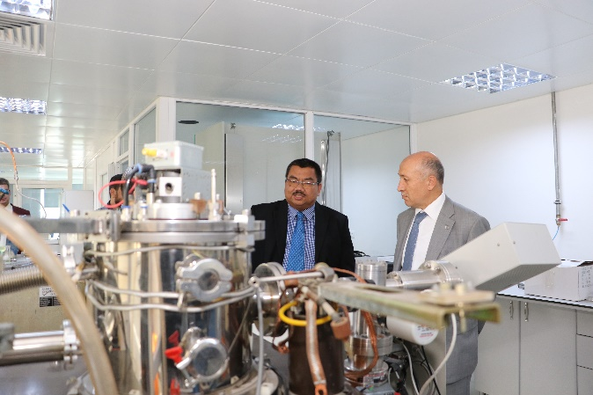
GREAT Learning @ UNIKA
FIRST AND ONL IRON AND STEEL INSTITUTE IN TURKEY
UNIKA IRON AND STEEL INSTITUTE
Dynamic Test Lab.
Residual Stress Measurement Lab.
Elementel Analysis Lab.
Sem Lab.
Static Test Lab.
Xrd&Xrf Lab.
Micro/Macro Measurement Lab.
Metallography Lab.
Energy and Environment Lab.
Dta/Dsc Lab.
Heat Treatment Lab.

Slide 10
GREAT Learning @ UNIKA
INDUSTRIES INVOLVEMENT

Slide 11
GREAT Learning @ UNIKA
INTERNATIONAL STUDENTS OF UNIKA
GERMANY
22
BULGARIA
21
UZBEKISTAN
152
AZERBAIJAN
749
TURKMENISTAN
510
RUSSIA
20
KAZAKHISTAN
33
JORDAN
259
KYRGYZSTAN
33
EGYPT
170
MOROCCO
26
CHINA
25
LIBYA
180
AFGHANISTAN
218
MAURITANIA
11
MALI
18
PAKISTAN
33
CHAD
685
BANGLADESH
17
From 90 country
8.050 international student
NIGERIA
25
IRAN
62
ARAKAN
45
CAMEROON
14
IRAQ
504
PALESTINE
105
DJIBOUTI
161
INDONESIA
13
SOMALIA
637
YEMEN
486
SAUDI ARABIA
22
The map shows countries with more than 10 students.
ETHIOPIA
10
SYRIA
1912

Slide 12
GREAT Learning @ UNIKA
INTERNATIONAL AGREEMENTS of UNIKA
UNIKA has more than
250
Bileteral agreements worldwide

Slide 13
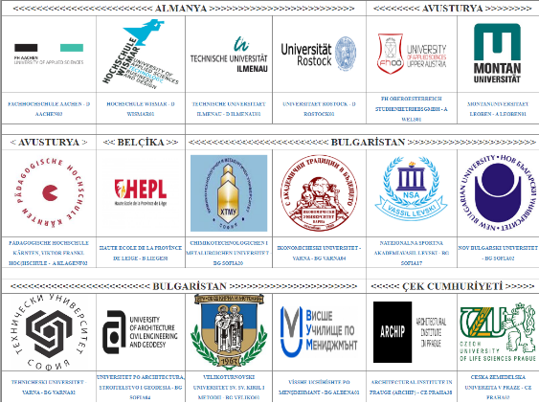
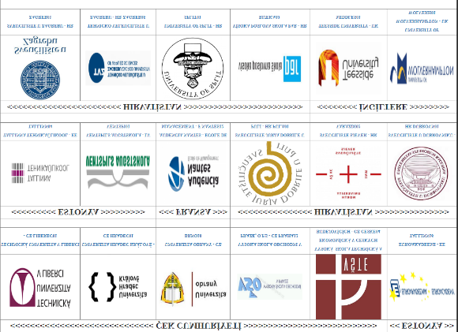
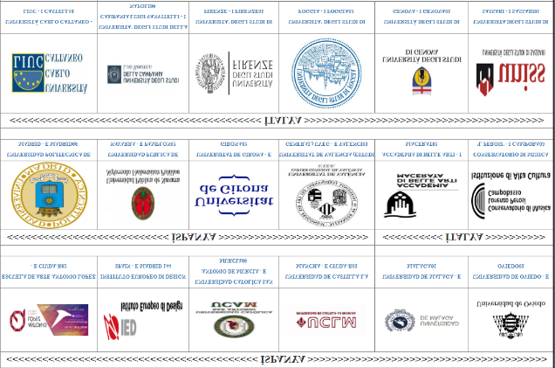
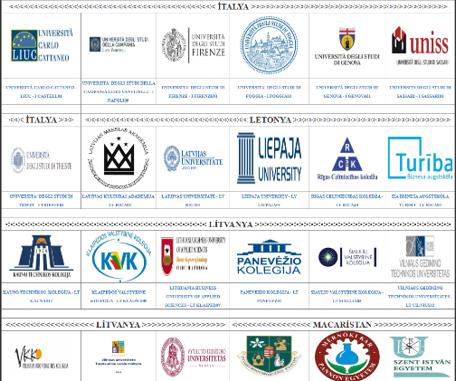
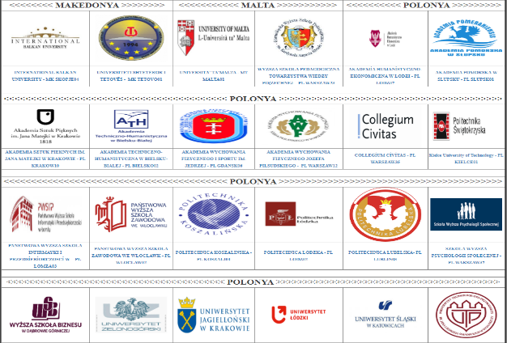
Some universities which we have agreements

Slide 14
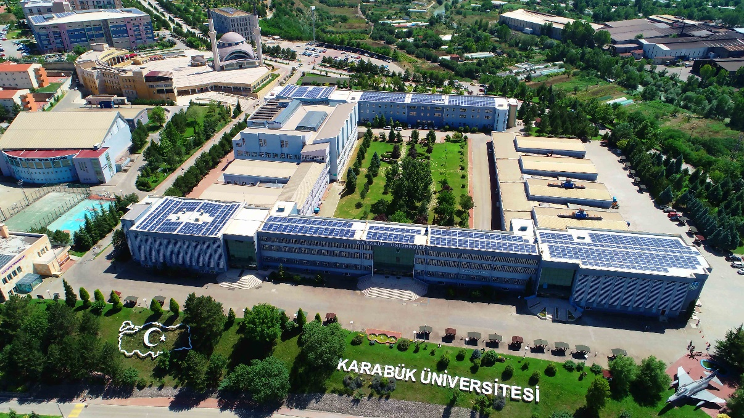
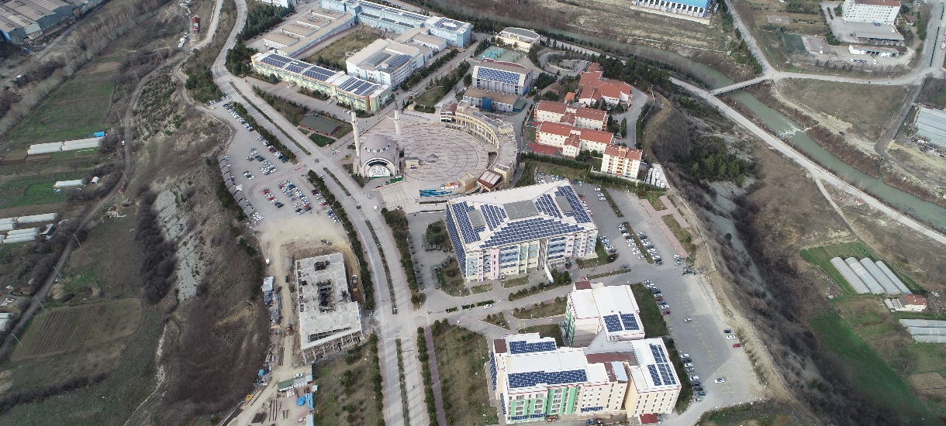
GREAT Learning @ UNIKA
Green Energy
UNIKA produces its own electrical energy by the solar panels that are placed on the roofs and side walls.
The solar panels are placed on 10.000 meter square and they produce the %50 need of electricity that is used in our university and in summer it is %70.

Slide 15
GREAT Learning @ UNIKA
UNIVERSITY of KARABUK
10
th
801-1000
IN TURKEY
WORLWIDE
www.karabuk.edu.tr
www.thewur.com

Slide 16
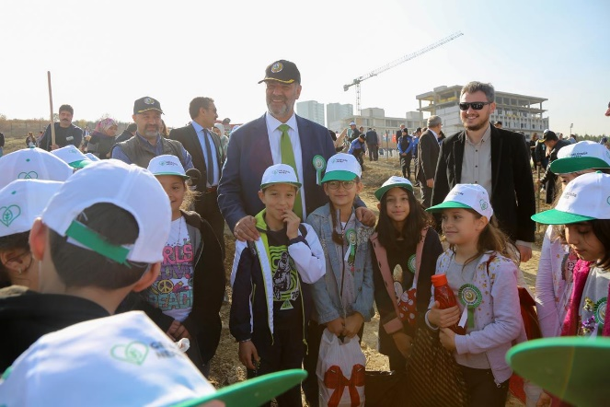
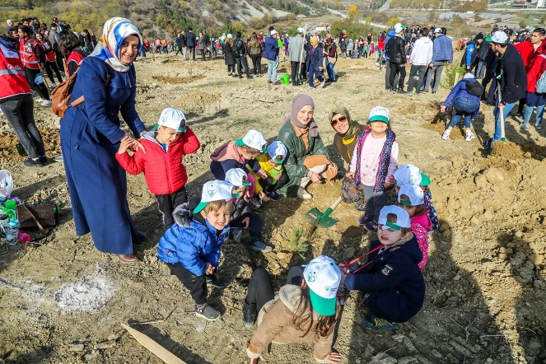
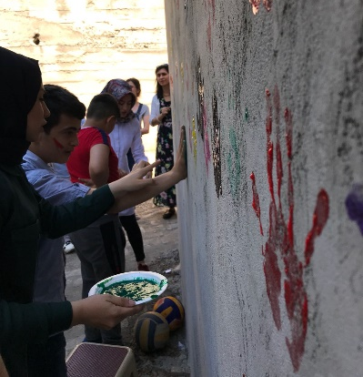
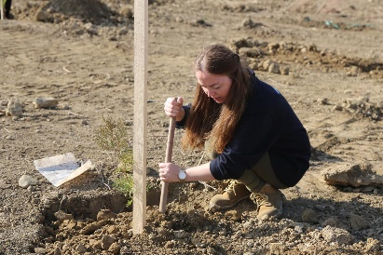
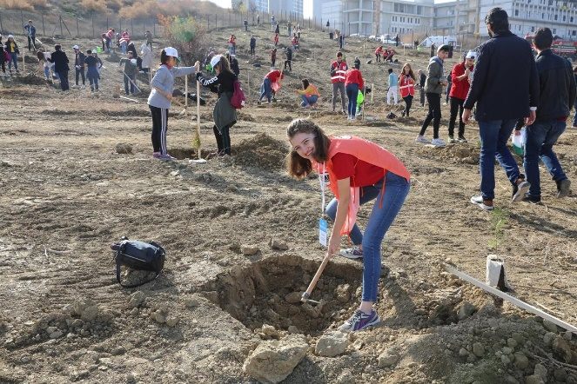
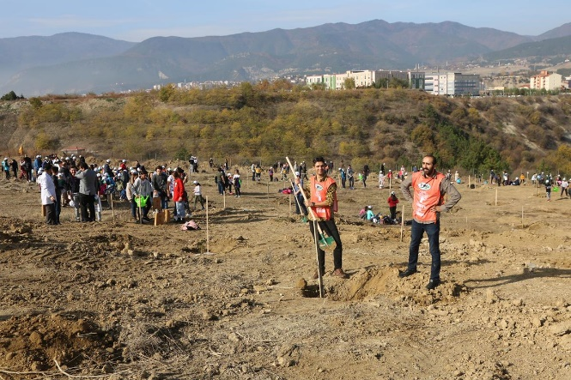
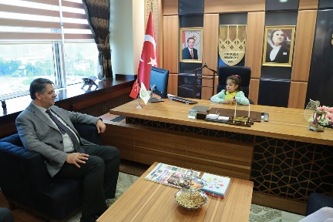
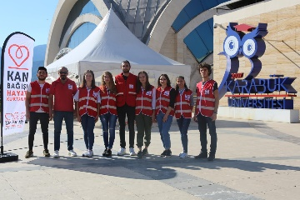
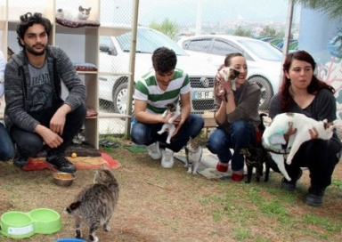
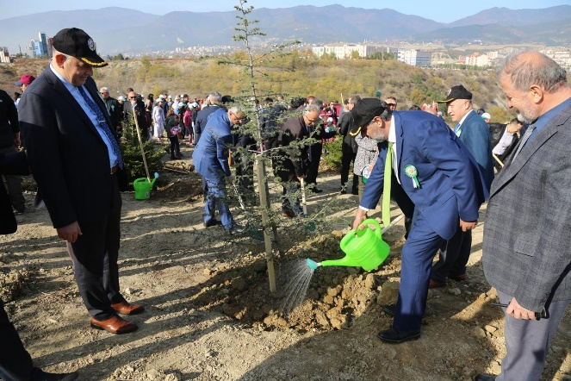
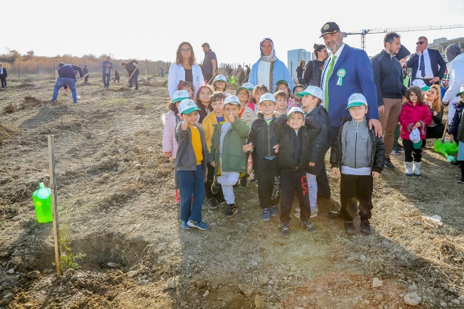
GREAT Achievement @ UNIKA
CORPORATE SOCIAL RESPOSIBILITY

Slide 17
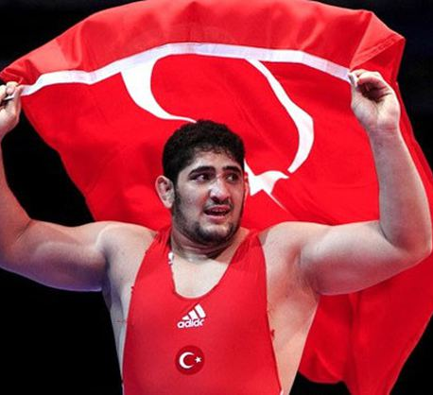
GREAT Achievement @ UNIKA
Osman Yıldırım, who is a student at UNIKA Sports Vocational School, came in first in the World University Wrestling Championship.
UNIKA students made a big mark on “2242 University Students Research Project competitions” organized by TUBITAK Scientist Support Program.

Slide 18
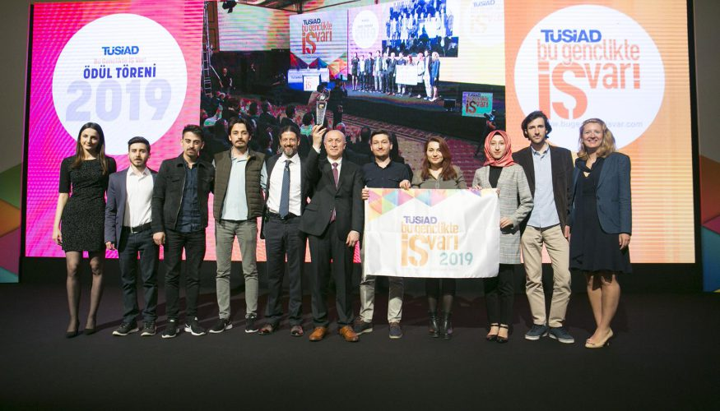
GREAT Achievement @ UNIKA
1. Turkish Airlines (THY)
391. University of Karabuk
3. Pegasus
…
2. SunExpress
UNIKA was ranked 391st in the list of top 500 service exporters in Turkey, where the Turkish Airlines was ranked as the first, announced by the Turkish Exporters Assembly. It is ranked 4th among the universities in Turkey.
UNIKA has received ‘Tüsiad Entrepreneurship Flag’ as the university that sends the most students to the ‘Entrepreneurship Camp’ of ‘Tüsiad Bu Gençlikte İş Var’ competition organized by the Turkish Industrialists' and Businessmen's Association (TÜSİAD) for university students since 2011.

Slide 19
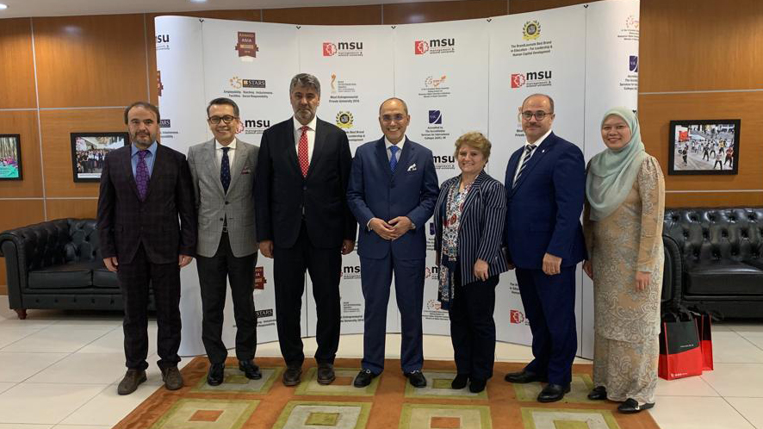
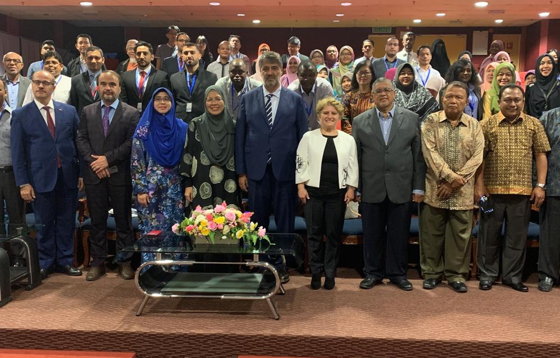
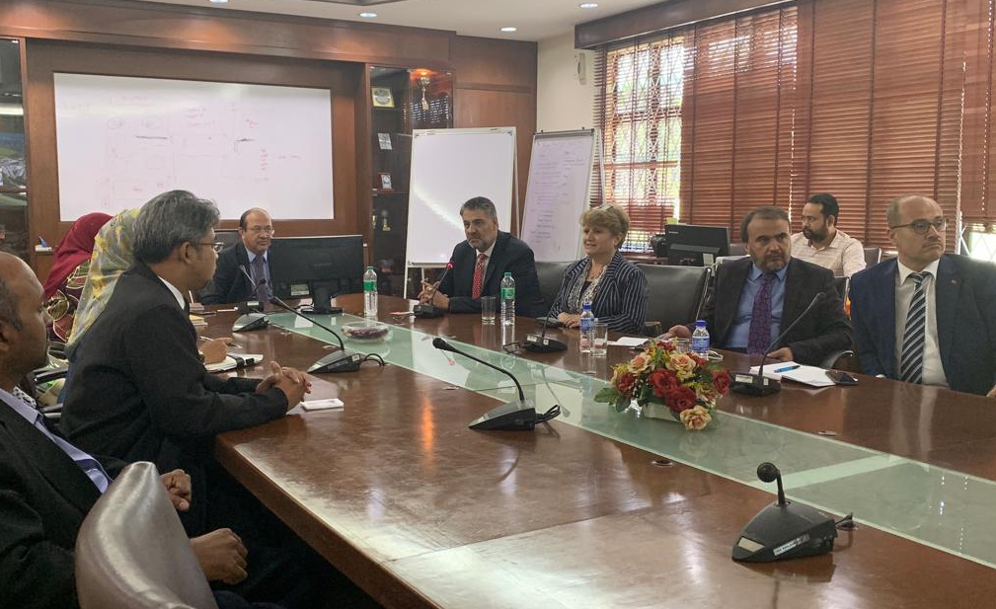
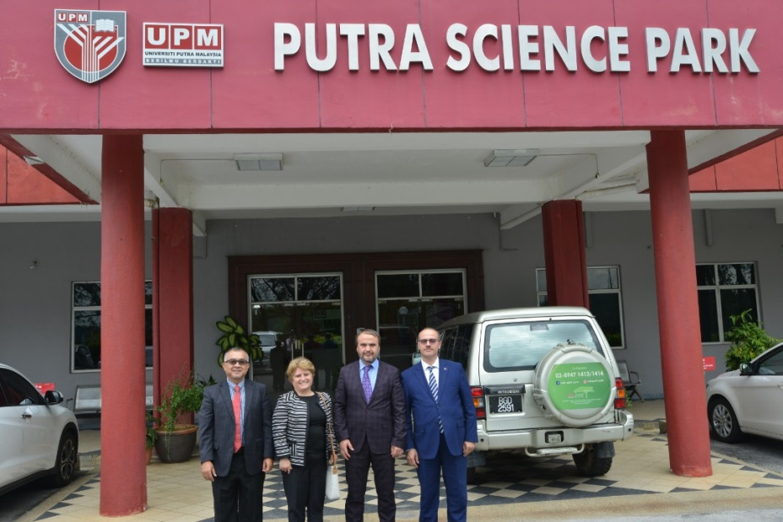
GREAT Global @ UNIKA
Agreements with partner universities

Slide 20
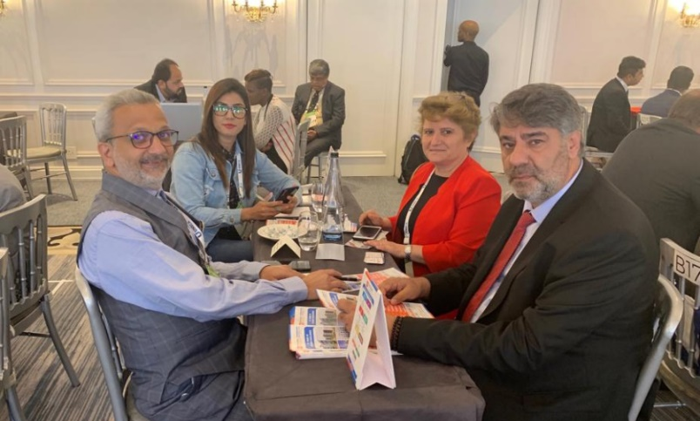
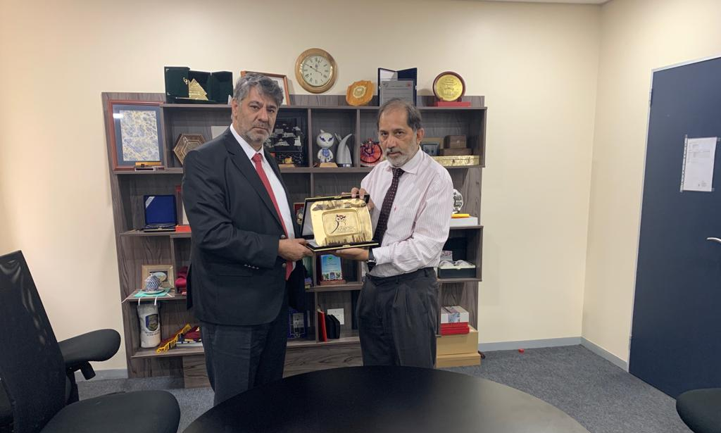
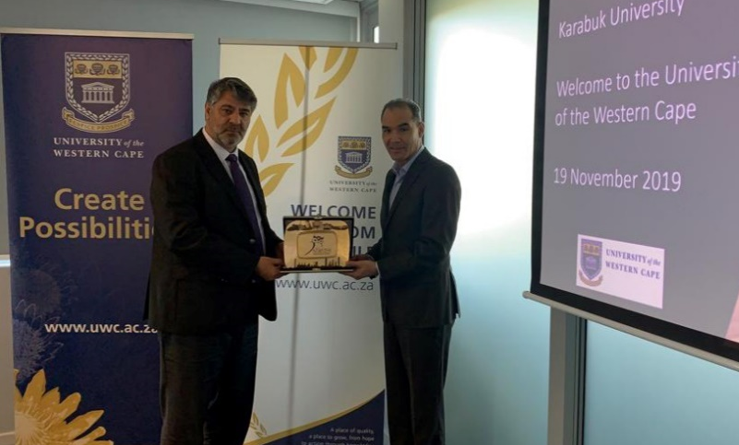
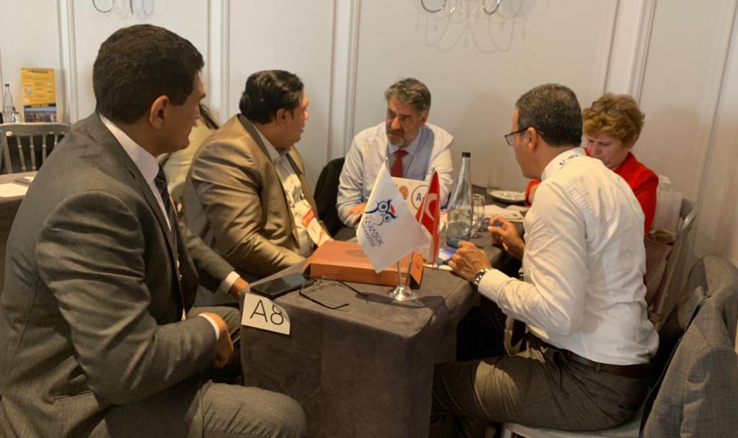
GREAT Global @ UNIKA
Agreements with partner universities

Slide 21
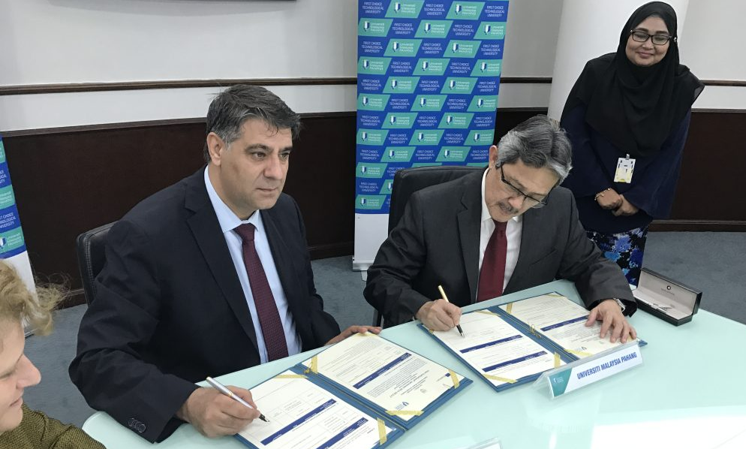
GREAT Global @ UNIKA
Agreements with partner universities

Slide 22
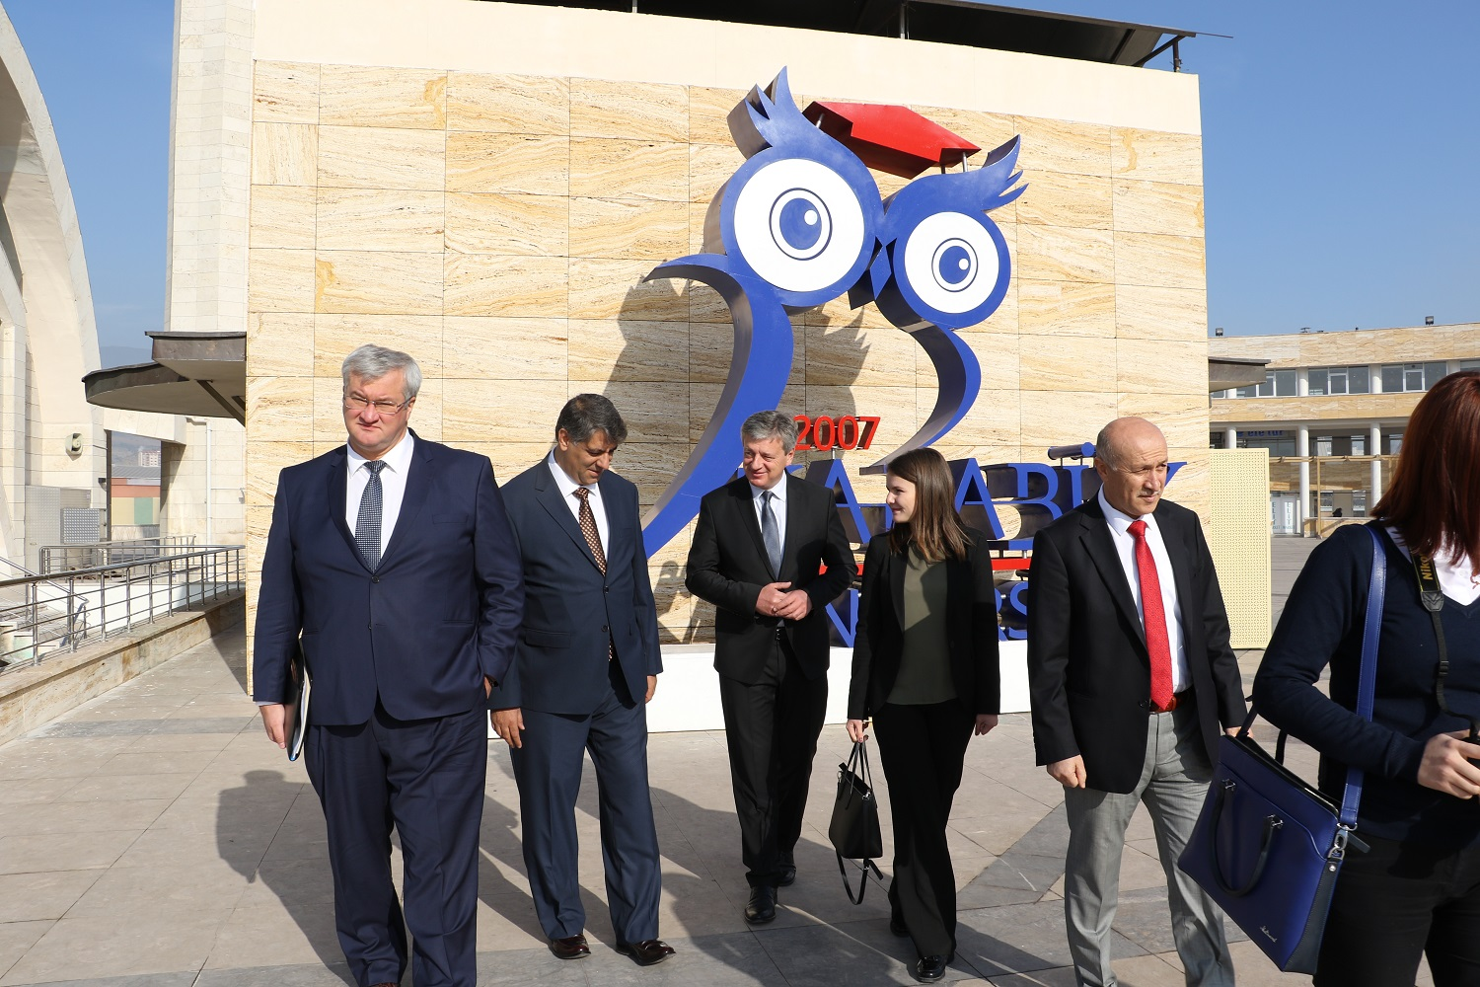
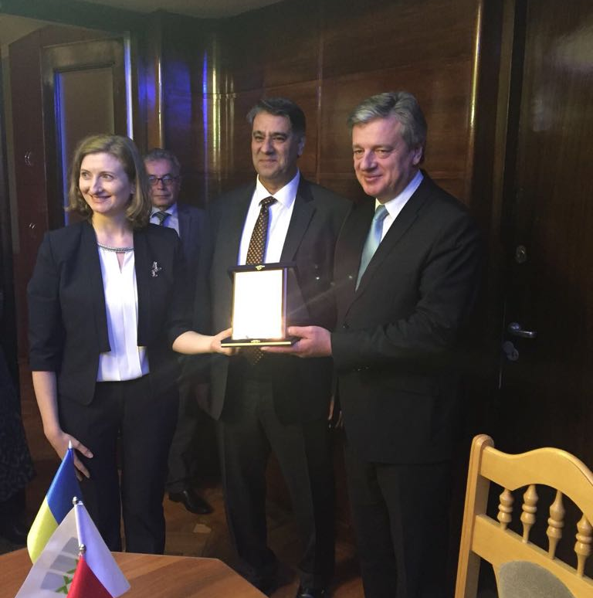
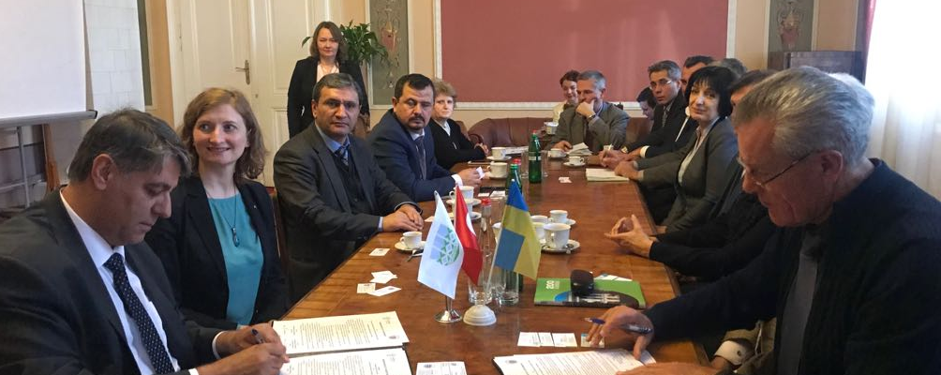
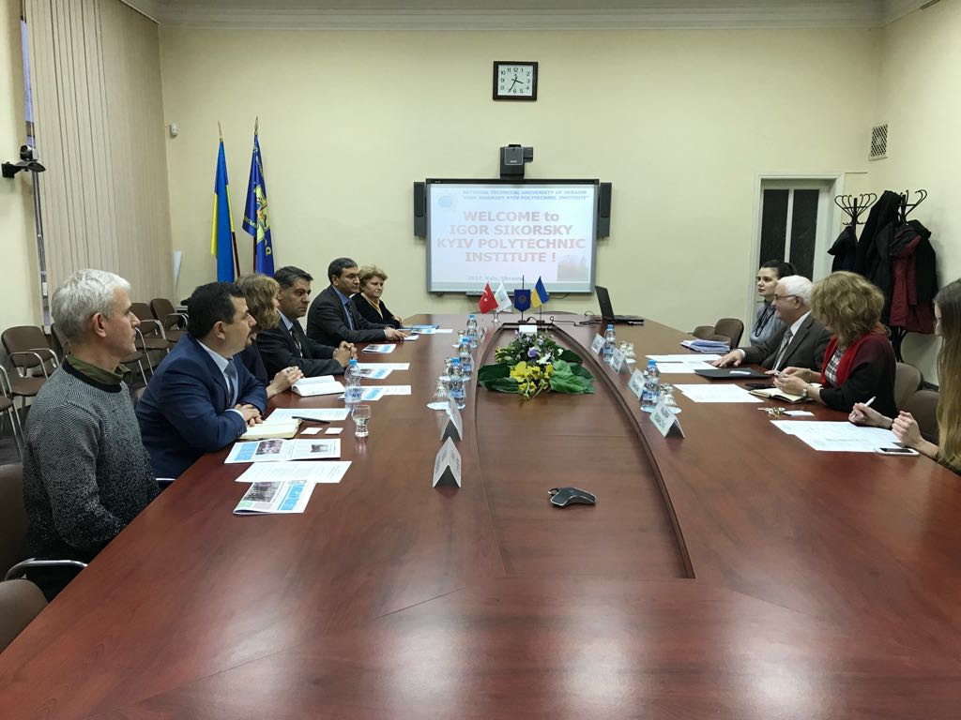
GREAT Global @ UNIKA
Agreements with partner universities

Slide 23
GREAT Global @ UNIKA
Agreements with partner universities

Slide 24
GREAT Global @ UNIKA
Agreements with partner universities

Slide 25
GREAT Global @ UNIKA
Participated in International Fairs

Slide 26
GREAT Global @ UNIKA
Participated in International Fairs

Slide 27
GREAT Global @ UNIKA
Participated in International Fairs

Slide 28
GREAT Global @ UNIKA
Participated in International Fairs

Slide 29
THANK YOU
/krbkuni
/karabukuniv
/kbu3nisantv

