Slide 1
Karabuk University 2021 – 2022

Slide 2
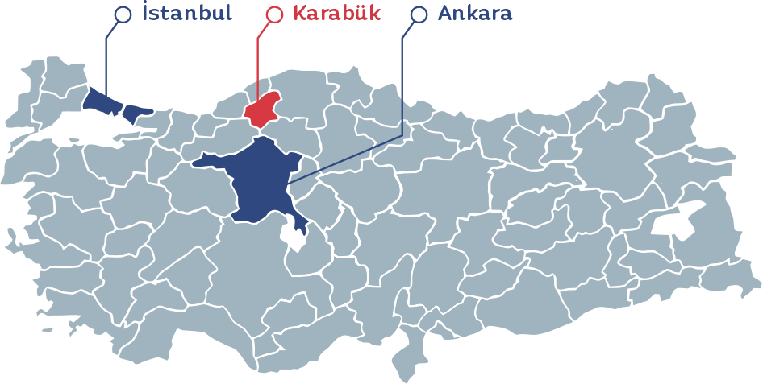
Where is Karabuk?

Slide 3
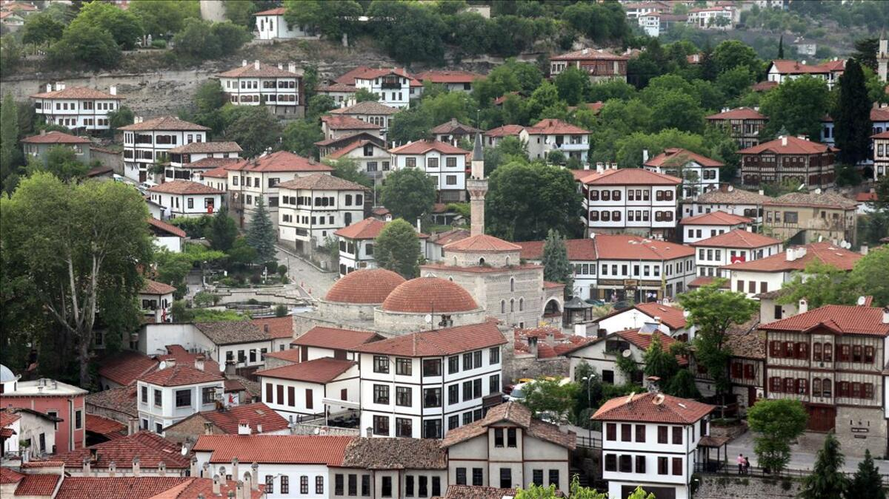
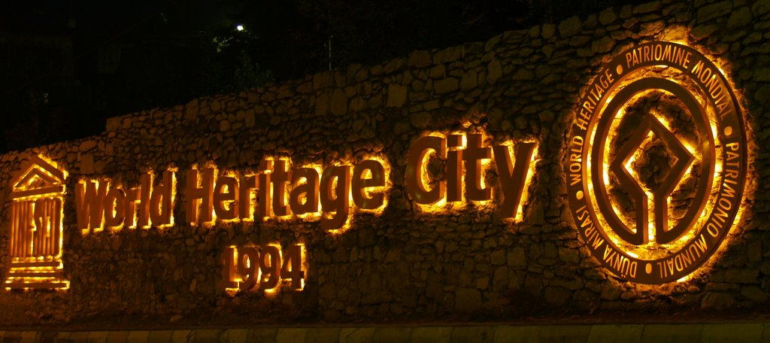
Safranbolu

Slide 4
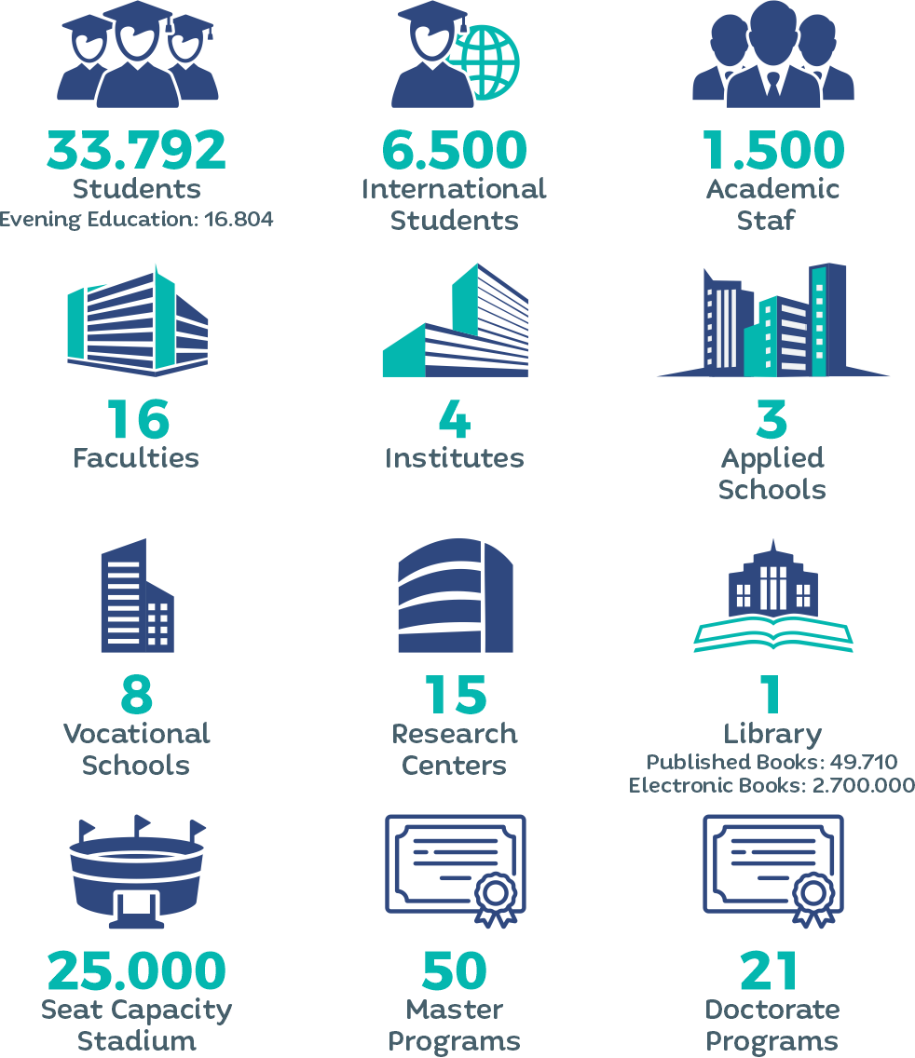
Karabük University (in numbers)
52.433
10.712
1.359
2
61
29

Slide 5
Campus

Slide 6
Contents
01
Academic Units
02
Students & Academic Staff
03
International Relations
04
Student Life
05
Rankings
,
06
Registration
www.karabuk.edu.tr

Slide 7
Academic Units
1

Slide 8
Academic Units
Institutes (2)
Faculties (16)
Applied Schools (3)
Vocational Schools (8)
School of Foreign Languages
Physical Education and Sports
Yenice Vocational School
Health Services Vocational School
Justice Vocational School
Civil Aviation
Eskipazar Vocational School
Safranbolu Vocational School
Safranbolu Şefik Dizdar Vocational School
Eflani Vocational School
The union of Chambers and Commodity Exchanges of Turkey Vocational School of Technical Sciences
Iron and Steel Institute
Institute of Graduate Programs
Faculty of Letters
Faculty of Science
Fine Arts and Design Faculty
Faculty of Economics and Administrative Sciences
Faculty of Technology
Faculty of Business Administration
Faculty of Engineering
Faculty of Forestry
Faculty of Health Sciences
Faculty Tourism
Faculty of Islamic Sciences
Faculty of Dentistry
Faculty of Communication
Faculty of Architecture
Faculty of Theology
Faculty of Medicine

Slide 10
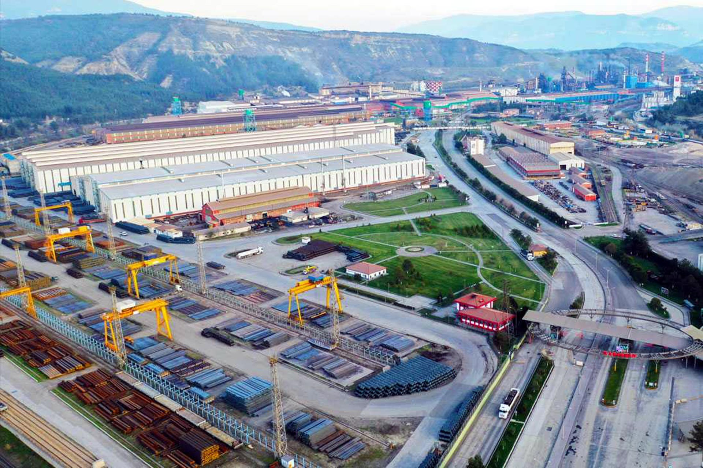
Kardemir Iron and Steel Factory

Slide 11
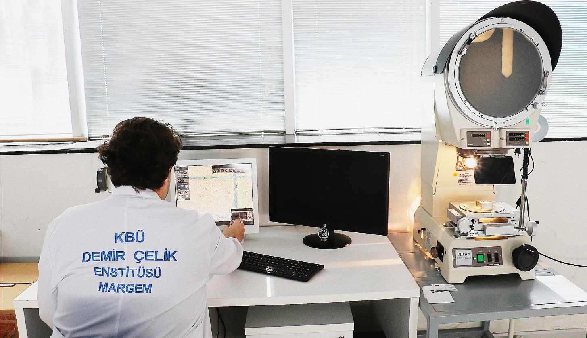
Natural and Applied Sciences

Slide 12
Natural and Applied Sciences
(27 Master Programs)
Master Programs
Mechanical Engineering
Electric-Electronic Engineering
Metallurgy and Materials Engineering
Energy Systems Engineering
Mechatronic Engineering
Metal Education
Furniture and Decoration Education
Computer Engineering
Electrical and Electronics Engineering (English)
Environmental Engineering
Polymer Engineering
Nuclear Medicine Physics
Mechanical Engineering (English)
Mathematics
Physics
Chemistry
Architecture
Manufacturing Engineering
Industrial Engineering
Industrial Design Engineering
Metallurgical and Materials Engineering (English)
Mechanical Education
Waste Management
Medical Biochemistry
Biomedical Engineering
Food Toxicology
Bioinformatics

Slide 13
Natural and Applied Sciences
(18 Doctorate Programs)
Doctorate Programs
Computer Engineering
Mechanical Engineering
Electrical-Electronics Engineering
Mechanical Education
Metal Education
Furniture and Decoration Education
Mechatronics Engineering
Industrial Design Engineering
Biomedical Engineering
Chemistry
Architecture
Manufacturing Engineering
Metallurgy and Materials Engineering
Energy Systems Engineering
Forestry Engineering
Mathematics
Physics
Waste Management

Slide 14
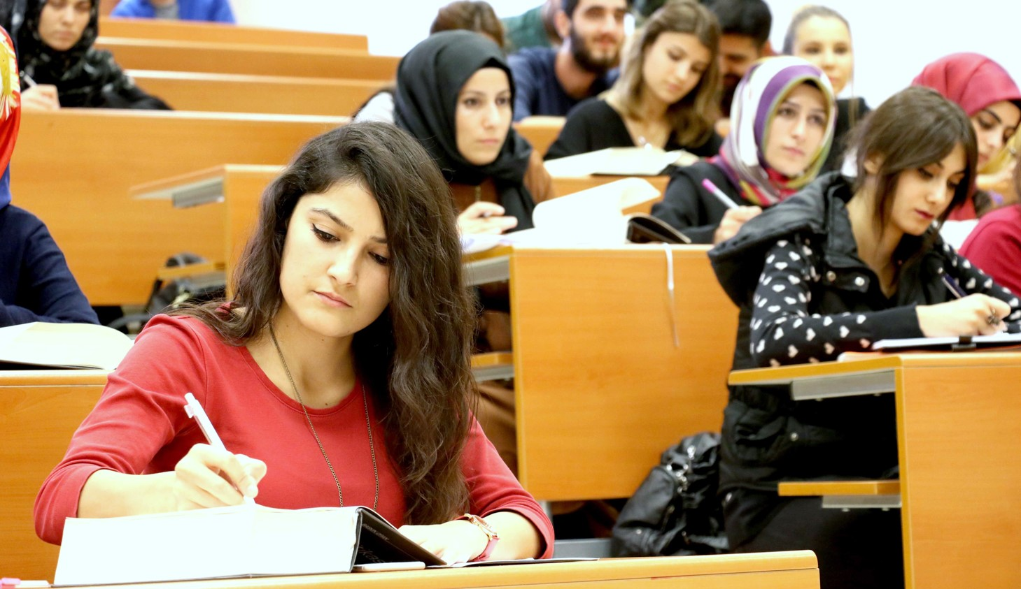
Social Sciences

Slide 15
Social Sciences
(22 Master Prorgams)
Master Prorgams
History
Business Administration
Public Administration
Sociology
Turkish Language and Literature
Economics
International Relations
Geography
English Language and Literature
Regional Studies
Communication
Basic Islamic Sciences
Entrepreneurship
Tourism Management
Tourism
International Political Economy
Art History
Actuary and Risk Management
Social Work
Ethıc Values
Finance and Islaming Banking
Philosophy and Religious Sciences

Slide 16
Social Sciences
(9 Doctorate Prorgams)
Doctorate Programs
History
Basic Islamic Sciences
English Language and Literature
Geography
Finance and Islamic Banking
Art History
Economics
Business Administration
Communication

Slide 17
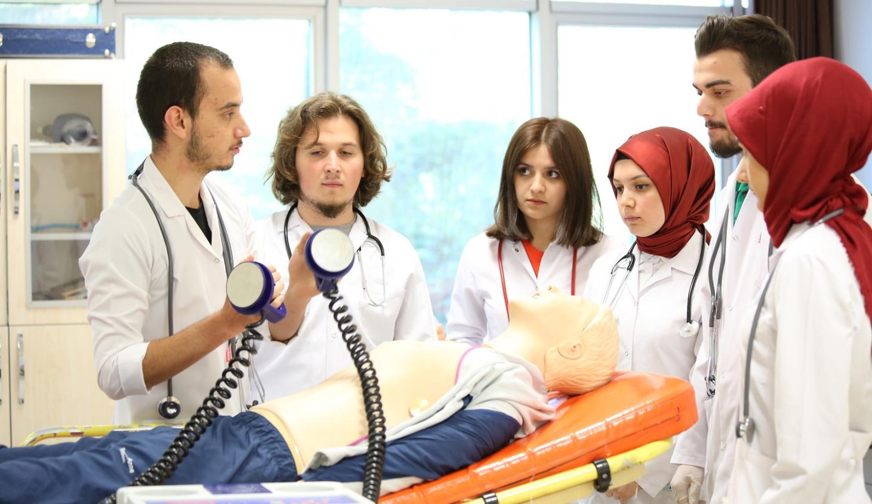
Health Sciences

Slide 18
Health Sciences
Master Prorgams (7)
Nursing
Midwifery
Child Development
Physical Therapy and Rehabilitation
Anatomy
Medical Microbiology
Health Institutions Management
Doctorate Prorgams (2)
Child Development
Anatomy

Slide 19
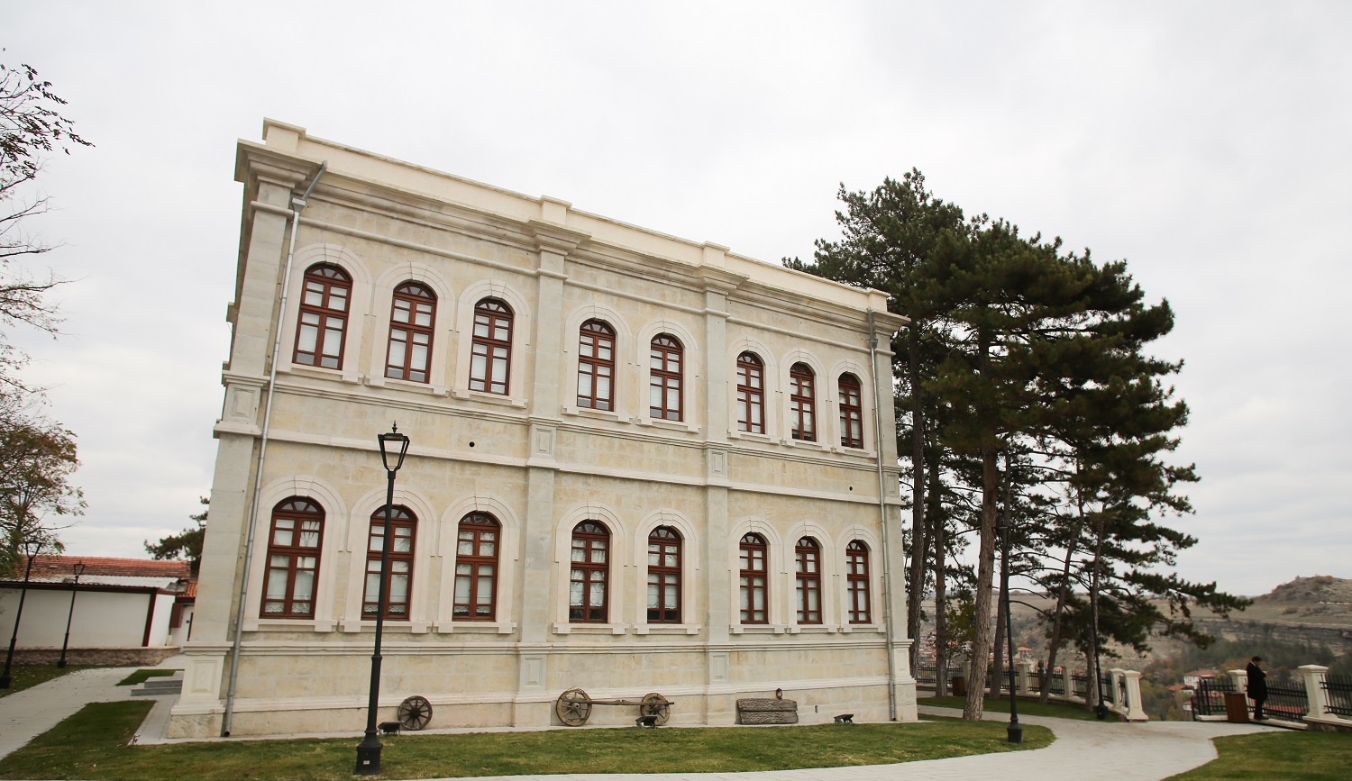
Fine Arts and Sport

Slide 20
Fine Arts and Sport
Master Prorgams (5)
Physical Education and Sports
Gastronomy and Culinary Arts
Archeology
Painting
Cultural Heritage and Heritage Management
Doctorate Prorgams
Painting

Slide 21
Faculties (16 Faculties -83 Programs)
Faculty Of Letters (10)
Art History
Faculty Of Sicence (5)
Physcis
History
Turkish Language and Literature
Sociology
Archeology
Geography
Psychology
Philosophy
Information and Document Management
Pedagogical Formation
English Language and Literature
Chemistry
Mathematics
Biology
Statistics

Slide 22
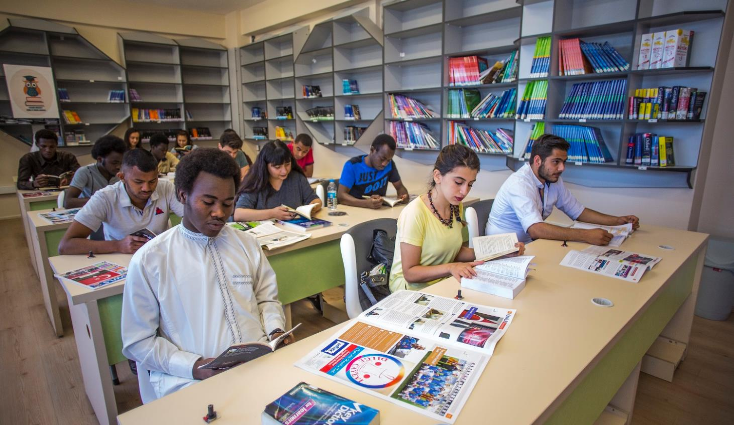

Slide 23
Faculties
Fine Arts And Design Faculty (7)
Painting
Business Administration
Faculty Of Economics And Administrative Sciences (7)
Music
Turkish Folk Music Main Art Discipline
Turkish Classical Music Home Art
Industrial Product and Design
Industrial Design
Graphic Design
Economics
International Relations
Public Administration
Social Work
Econometrics
Management Information Systems

Slide 24
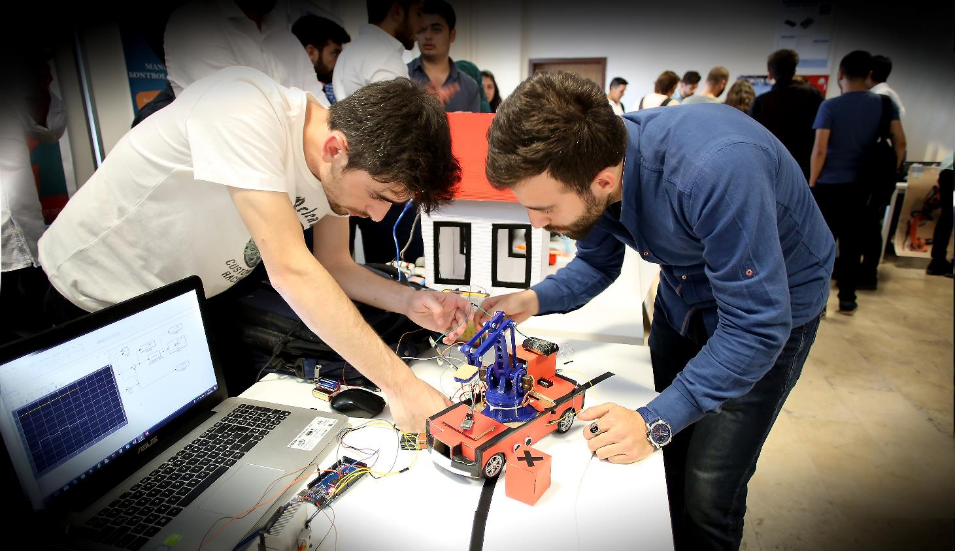

Slide 25
Faculties
Faculty Of Technology (5)
Mechatronics Engineering
Business Administration
Faculty Of Business Administration (9)
Energy Systems Engineering
Manufacturing Engineering
Industrial Design Engineering
Faculty Of Theology (2)
Industrial Design Engineering
Theology
Elementary Religious Culture and Moral Education
Actuarial and Risk Management
Actuarial Sciences
International Business
Finance and Banking
Tourism Management
Tourism Guidance
Entrepreneurship
Public Relations and Advertising

Slide 26
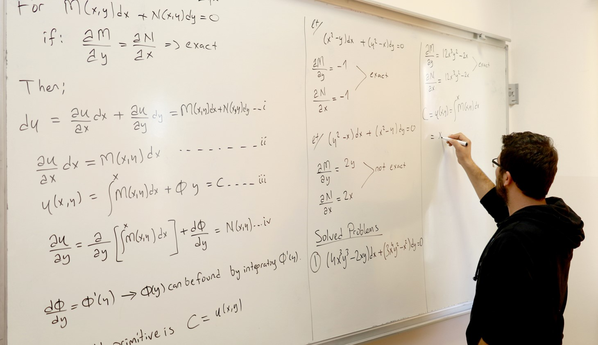

Slide 27
Faculties
Faculty Of Engineering (20)
Mechanical Engineering (English)
Faculty Of Forestry (3)
Forestry Industry Engineering
Electrics-Electronics Engineering(English)
Computer Engineering(English)
Metallurgical and Materials Engineering(English)
Automotive Engineering(English)
Computer Engineering
Forestry Engineering
Landscape Architecture
Medical Engineering (English)
Metallurgical and Materials Engineering
Industrial Engineering
Automotive Engineering
Mechanical Engineering
Automotive Engineering
Railway Systems Engineering
Electrical and Electronics Engineering
Mechatronics Engineering
Environmental Engineering
Civil Engineering
Transportation Engineering
Biomedical Engineering
Medical Engineering

Slide 28
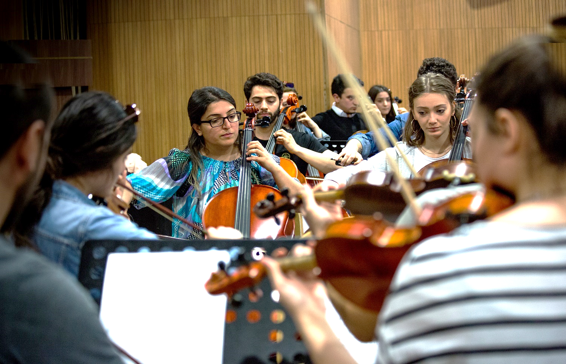

Slide 29
Faculties
Faculty Of Health Sciences (5)
Department Of Nursing
Faculty Of Medicine
Faculty Of Tourism (4)
Physiotherapy And Rehabilitation
Department Of Midwifery
Department Of Child Development
Department Of Nutrition And Dietetics
Faculty Of Dentistry
Faculty Of Architecture
Faculty of Communication (2)
Tourism Management
Gastronomy and Culinary Arts
Tour Guide Training
Recreation Management
Radio, Television and Cinema
Journalism

Slide 31
Students & Academic Staff
2

Slide 32
47.431 Undergraduate Students
5.002 Post Graduate Students
10.712 International Students

Slide 33
INTERNATIONAL STUDENTS OF UNIKA FAMILY
90 different countries
More than 10k students

Slide 36
International Relations
3

Slide 38
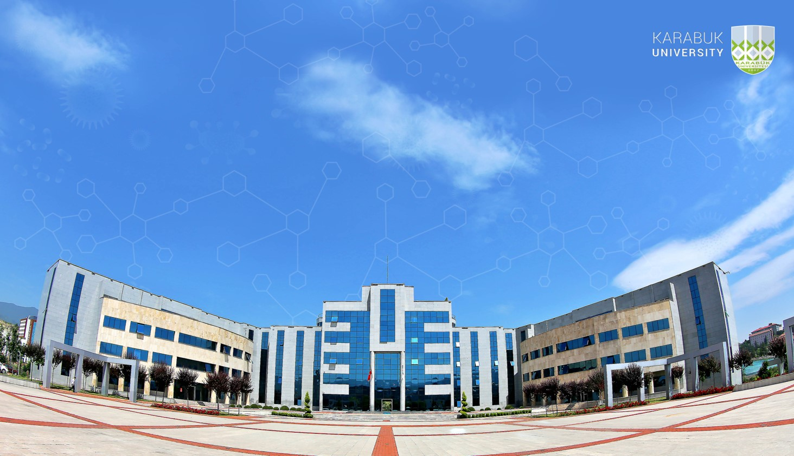
Karabuk University (KBU) is a public university which offers BA, MA, MSc, PhD programme studies, intended to be compatible with the requirements implies by the Bologna Process.
KBU holds a valid (2014-2020) Erasmus Extended Charter and has been awarded Diploma Supplement Label (DS) 2011-2014 and ECTS Label 2013-2016 by European Commission.

Slide 39
What is Erasmus?
Erasmus+ is the EU's programme to support education, training, youth and sport in Europe. Its budget of €14.7 billion will provide opportunities for over 4 million Europeans to study, train gain experience, and volunteers abroad.
The Erasmus+ Programme is a European funding programme established in 1987 offering university students a possibility of studying or doing an internship abroad in another country for a period of at least 2 months and maximum 12 months per cycle of studies.
Organisations wanting to participate in Erasmus+ may engage in a number of development and networking activities, including strategic improvement of the professional skills of their staff, organisational capacity building, and creating transnational cooperative partnerships with organisations from other countries in order to produce innovative outputs or exchange best practices.

Slide 40
288
KBU has more than
Bileteral agreements worldwide
150 MoU – 138 Erasmus+

Slide 41
KA131 Partnerships
Germany 4
Austria 3
Bulgaria 8
Belgium 1
Checz Republic 7
Estonia 2
France 1
Crotia 7
Spain 10
Italy
9
Latvia 9
Lithuania 7
North Macedonia 2
Malta 1
Poland 25
Portugal 6
Romania 21
Slovakia 2
Greece 6

Slide 42
KA171 Partnerships (MoU)
Azerbaijan 2
Bangladesh 1
Belarus 1
Bosnia Herzegovina 1
Brasil 2
Cibuti 1
Czech Republic 1
China 2
Indonesia 35
Morocco 1
Jordan 3
Palestinia 1
South Korea 3
Netherlands 1
India 7
Iraq 1
Iran 4
Italy 1
Japan 1
Kazakhistan 7
Krgyzystan 3
Lithuania 2
France 1
North Macedonia 1
Malaysia 8
Uzbekistan 21
Pakistan 2
Poland 1
Romania 3
Russia 3
Sudan 14
Taiwan 2
Ukraine 8
Senegal 3
USA 2

Slide 43
Student Life
4

Slide 44
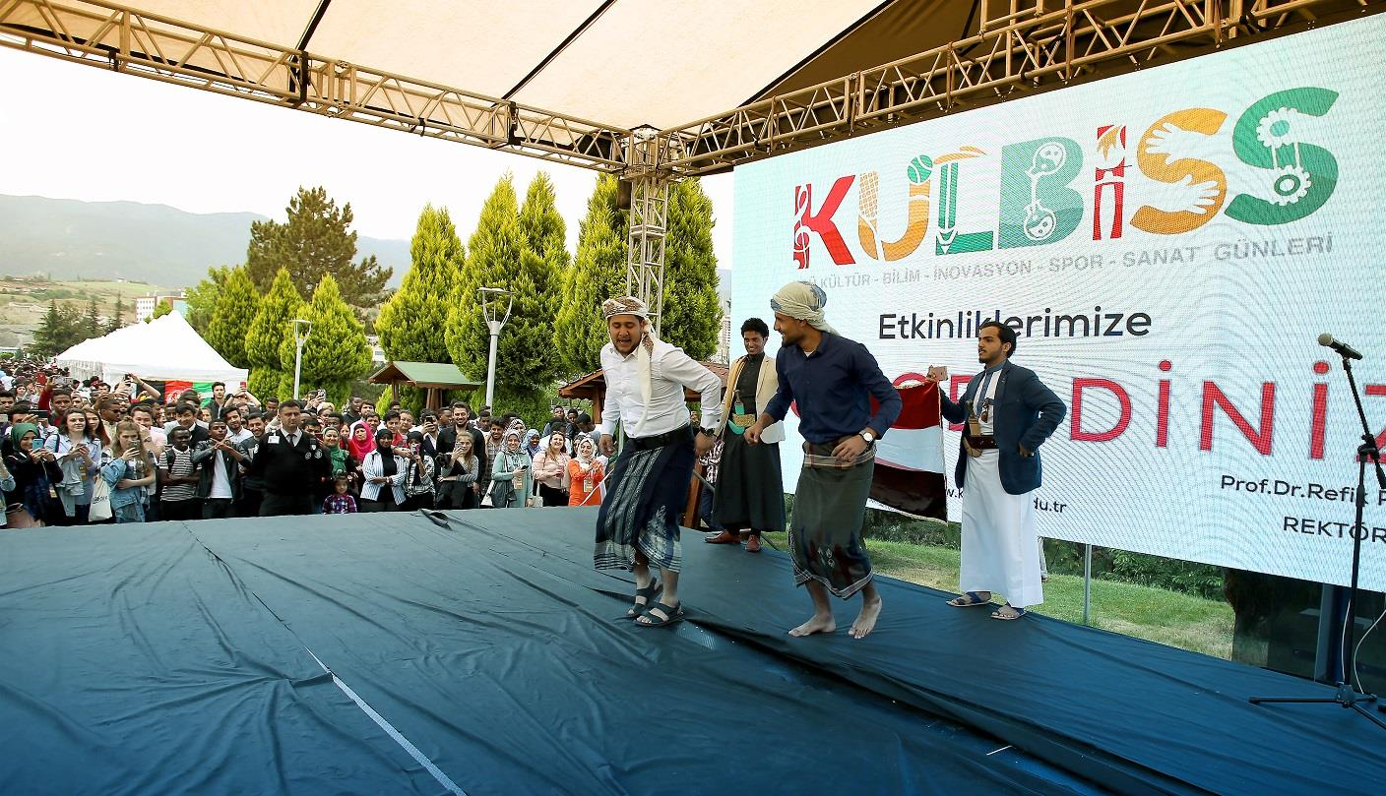

Slide 45
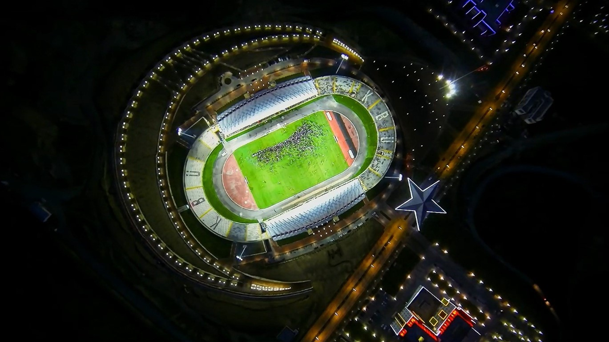
25.000 seat capacity Stadium with the shape of the star and crescent in Turkish Flag

Slide 46
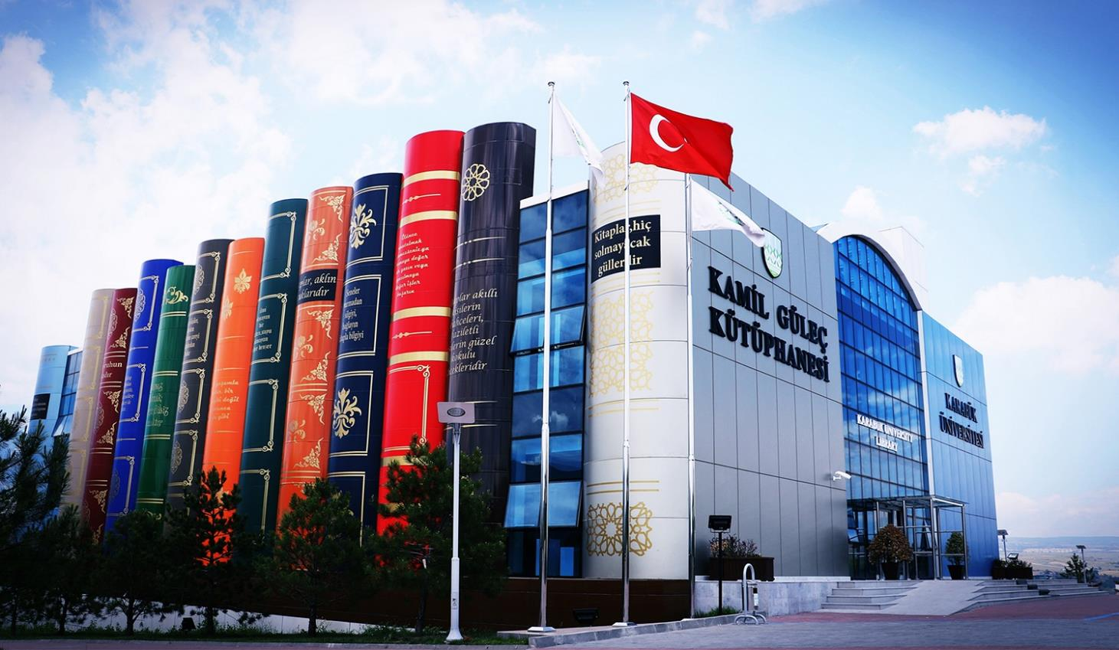
Library

Slide 47
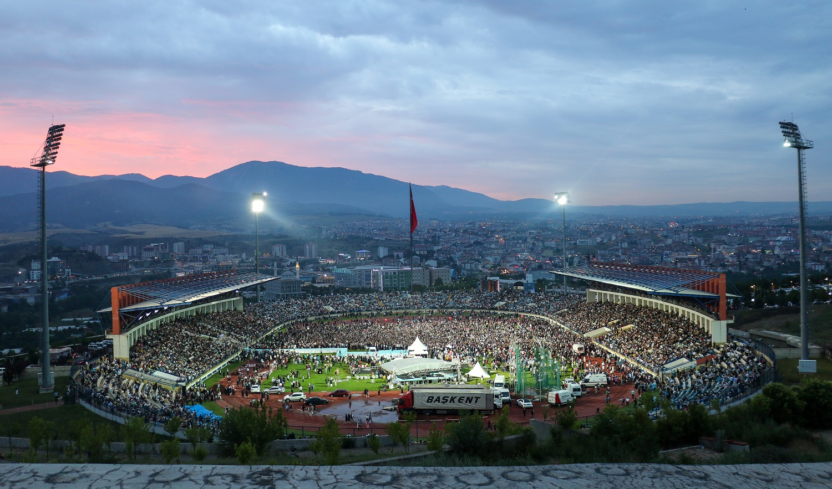
Graduation
2019

Slide 48
Living at Karabuk University brings surprises and new experiences every day, in an extraordinary community of creative and accomplished people.

Slide 49
Rankings
5

Slide 50
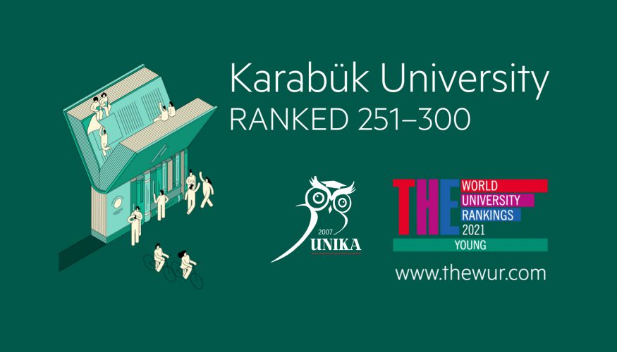
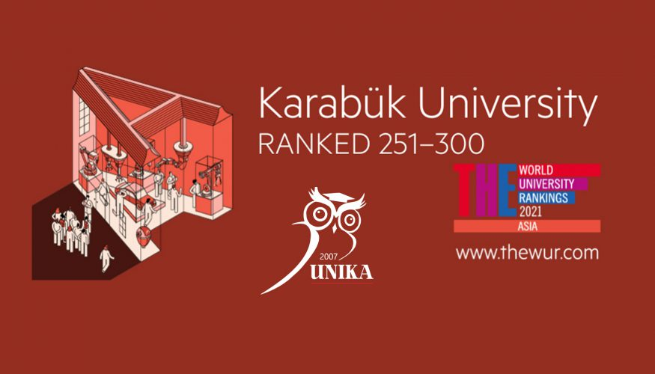
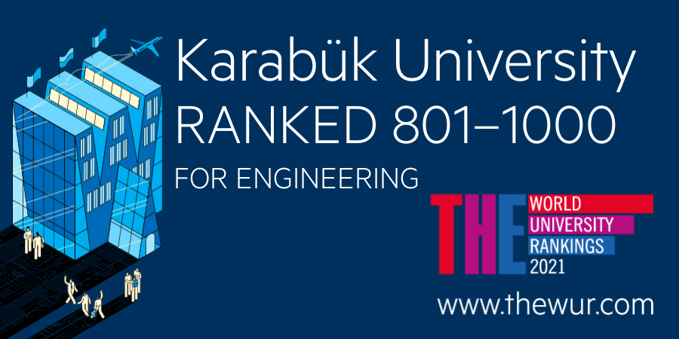
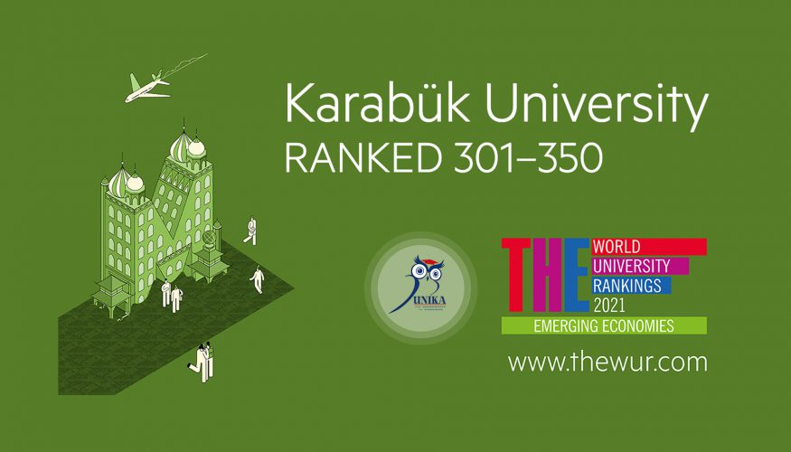
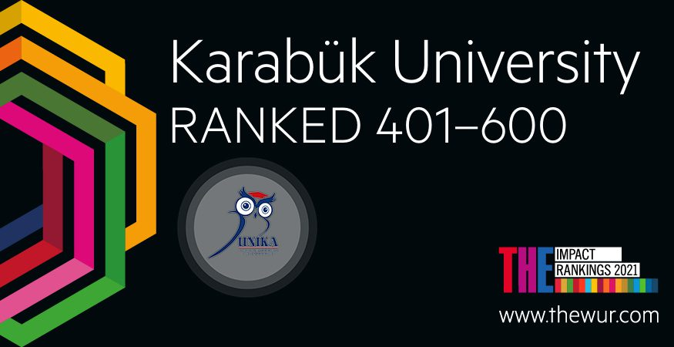

Slide 51
Registration
6

Slide 52
Tuition Fee for International Students for 2021 - 2022 Academic Year
Faculty | Daytime Education ₺ | Evening Education ₺
Faculty of Medicine | 30000 | -
Faculty of Dentistry | 20000 | -
Faculty of Engineering Faculty of Letters (English %30) Faculty of Letters (English %100) | 6000 6000 9000 | 6200 6200 9200
Fine Arts and Design Faculty | 7000 | 7200
Faculty Of Technology | 5500 | 5700
Faculty Of Health | 4500 | 4700
Faculty of Science | 4600 | 4800
Faculty of Economics and Administrative Sciences Faculty of Economics and Administrative Sciences (English %100) | 4150 6250 | 4350 6450
Faculty of Business Administarion | 4150 | 4350
Faculty of Letters Faculty of Letters (English %100) | 3700 5520 | 3900 5720
Physical Education and Sports | 4500 | 4700
Faculty of Tourism | 3700 | 3900
Faculty of Theology | 3700 | 3900
Faculty of Architecture | 7000 | -
Faculty of Forestry | 5500 | -
Faculty of Communication | 4000 | -

Slide 53
Tuition Fee for International Students for 2021 - 2022 Academic Year
Schools/Vocational Schools | Daytime Education ₺ | Evening Education ₺ | Distance Education ₺
Eflani Vocational High School | 2800 | - | -
Justice Vocational High School | 2800 | 3000 | -
Eskipazar Vocational High School | 2800 | 3000 | 3500
Hasan Doğan Sport and Physical Education High School | 4500 | 4700 | -
Safranbolu Vocational High School | 2800 | 3000 | 3500
Safranbolu Vocational High School (English 100%) | 4200 | 4400 | -
Health Services Vocational High School | 3000 | 3200 | 3700
School of Health | 4500 | 4700 | -
TOBB Vocational High School | 2800 | 3000 | -
Yenice Vocational High School | 2800 | - | -

Slide 54
Tuition Fee for International Students for 2021 - 2022 Academic Year
Institutes | Daytime Education ₺
Health Sciences | 5500
Natural and Applied Scinces | 5500
Social Sciences | 5500

Slide 55
QUESTION AND ANSWER
THANKS FOR THE PARTICIPATION!!

Slide 56
Karabuk University
www.karabuk.edu.tr
KARABUK UNIVERSITY
INTERNATIONAL RELATIONS OFFICE
Balıklar Kayası Mevkii Demir Çelik Campus
Rectorship C Block 3. Floor
100. Yıl 78050 Karabük/TURKEY
internationaloffice@karabuk.edu.tr
+90 370 418 80 49
Fax: +90 370 418 94 07

